Slide 1
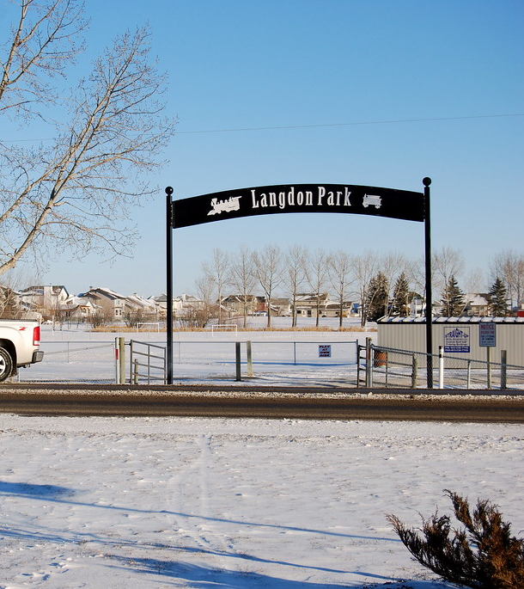

Welcome to the
Langdon Area Structure Plan Amendment Open House #2
This Open House is being held to present the draft Area Structure Plan with edits.

Slide 2
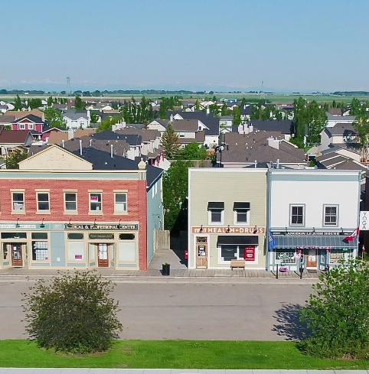

Proposed Vision
Langdon is a complete community that supports modern lifestyles through a diversity of housing styles and prices, local employment opportunities and community amenities, ensuring recreation and educational facilities are available and accessible for a safe, sustainable community.

Slide 3
What we Heard
Through the comment sheets from Open House #1, email correspondence and the on- line survey (405 responses), the community provided comments on their major concerns.
We have incorporated policies to address these concerns.
It is recognized that growth will be slow but steady and that only growth will support and pay for the services the community wants.
Top Concerns
Keep the smalltown feel
Loss of agricultural land
Water and sewer capacity
Glenmore Trail
More paths and trails and indoor recreation (ice rink)
Maintain the heritage architectural feel
Seniors Housing

Slide 4
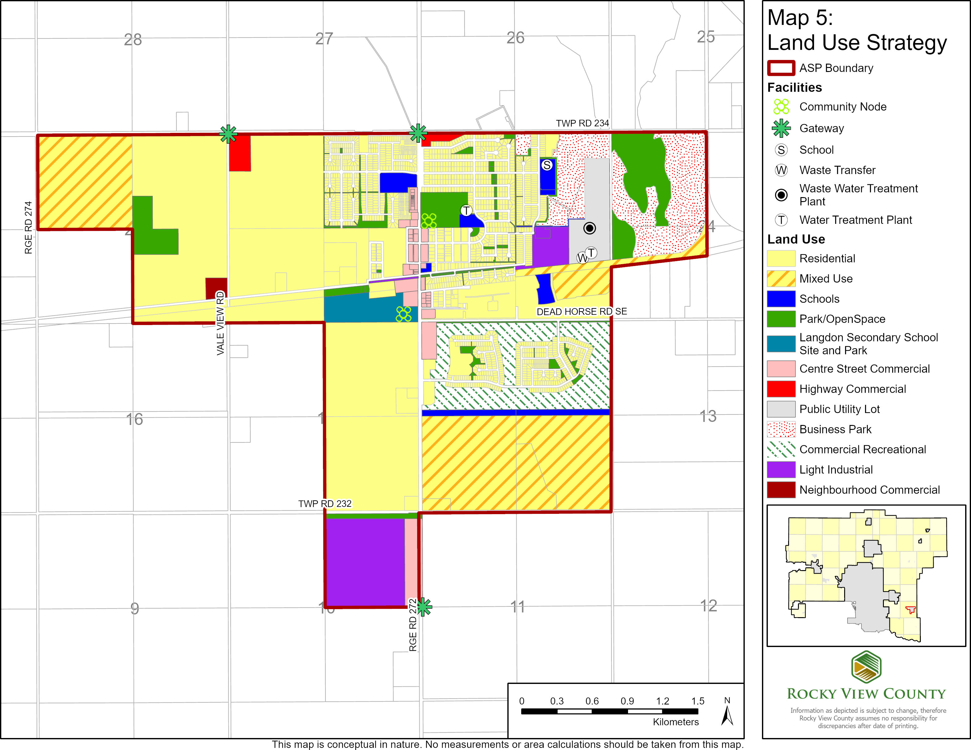
Proposed Concept
The proposed concept adds four quarter sections of land into the hamlet boundary.
The east half of Section 21 is designated for residential and school and park land. The Northwest of Section 21 is designated mixed use for the future to lands in the west are phased to develop the NE21 a mix of non residential and residential uses.
The NE of Section 10 is identified for light industrial with an extension of Centre Street Commercia. This will provide employment, services and tax base.
The remainder of the hamlet land use remains as was allocated in the 2012 Area Structure Plan.

Slide 5
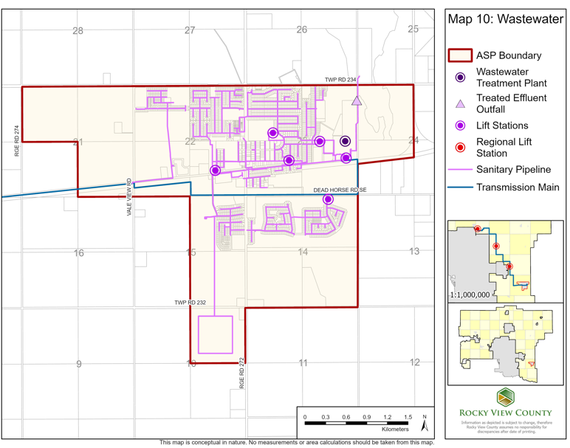
Sanitary Sewer
Sanitary sewer collection and treatment is provided by Rocky View County.
No new development can proceed until the capacity to service the development with Sanitary sewer is demonstrated.
Developer will be responsible for construction of the distribution systems.

Slide 6
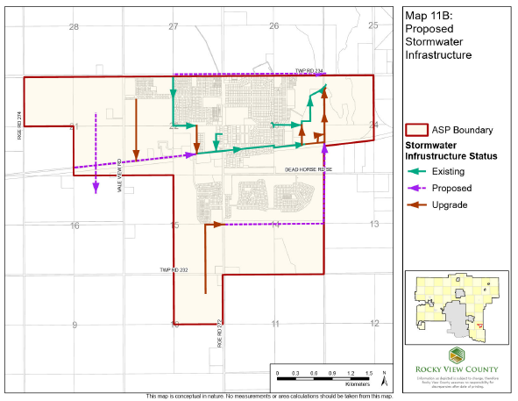
Stormwater
The Langdon area is relatively flat. Stormwater management is critical.
Weed Lake provides a destination for stormwater.
Development is encouraged to use low impact elements and permeable surfaces to reduce site runoff.
New development will be required to meet standards for on site storm water detention, retention and treatment through ponds.

Slide 7
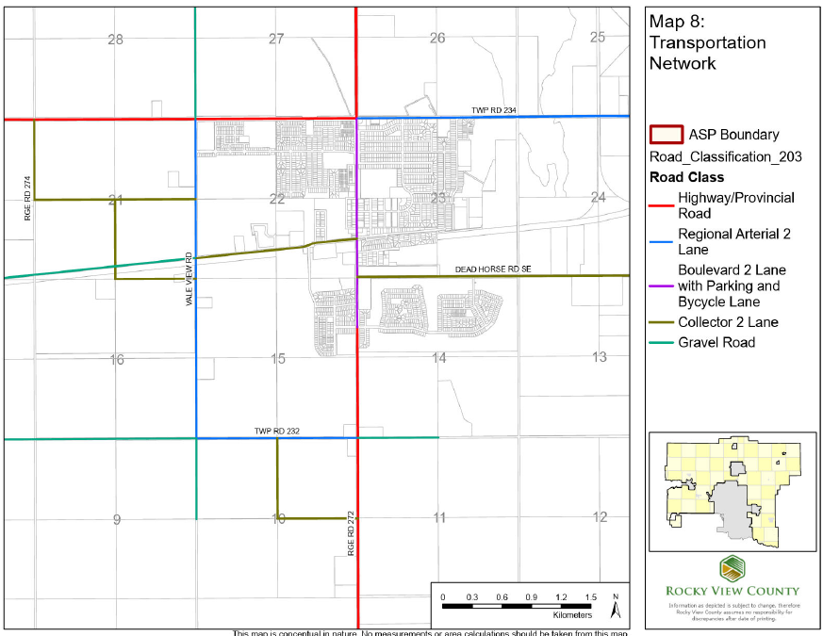
Transportation Network
Langdon is serviced by provincial highways: Glenmore Trail (SR 560) and Centre Street (SR 797)
4 miles south of the TransCanada Highway and 2.5 miles north of Highway 22X
Access at Centre Street and Vale View Roads at Glenmore Trail will be upgraded as development progresses.
Developers will be responsible for construction of roads for new development and contribution to upgrades to the road network.
All roads will meet County standards

Slide 8
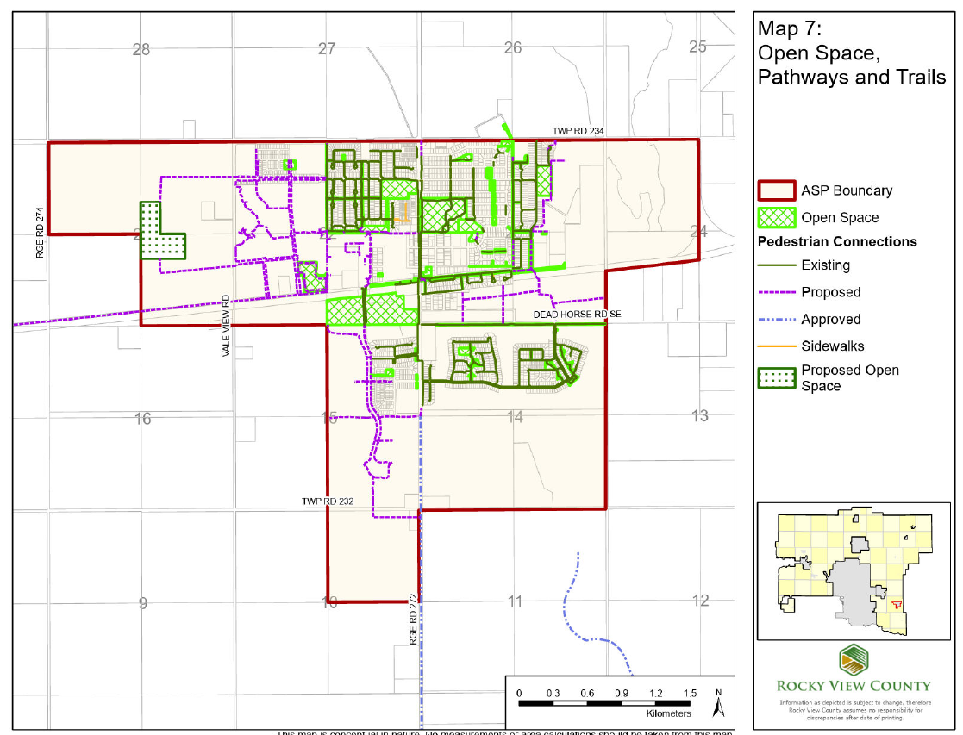
Parks, Open Space and Pedestrian Environment
The ASP proposes new paths, trails open space, parks and playgrounds.
The Community strongly supported a future indoor recreation facility (specifically including an ice rink). While a specific location is not identified, lands will be allocated for future parks and recreation uses.
Paths and trails are proposed to be multi purpose to accommodate pedestrian and cycling.
Future school sites are proposed in the east half of Section 21 to support the continued growth of the hamlet.

Slide 9
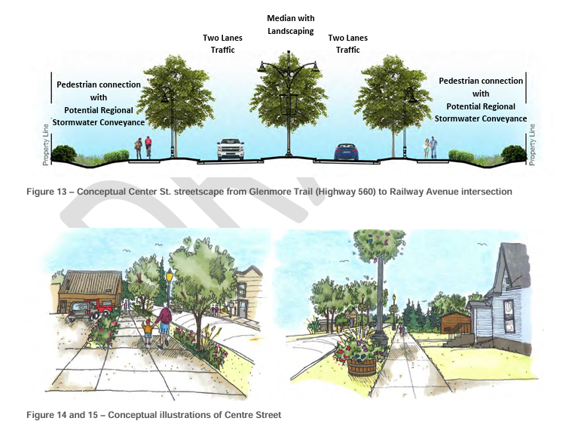
Design Guidelines
Draft Centre Street Design Guidelines were prepared in 2015 but not adopted.
As part of the ASP Amendment process, we will support the adoption of Design Guidelines that will emphasize:
Landscaped street cross sections
Improved Pedestrian Connectivity
Enhance Safety and Aesthetics
Sustain Heritage Character
Stimulate Business and Investment
Create Network of Green Spaces and Community Gathering Spaces
Improve Stormwater Drainage
Street Orientation for Buildings
Accessibility for all Ages and Abilities

Slide 10
Next Steps
Council authorization
Background reports
Approval Process
Open House #1
February 11, 2025
Online Survey
March 2025
Prepare Draft Plan
Open House #2
June 24, 2025
First Reading
Formal Circulation and Public Hearing
We are here

